Slide 1
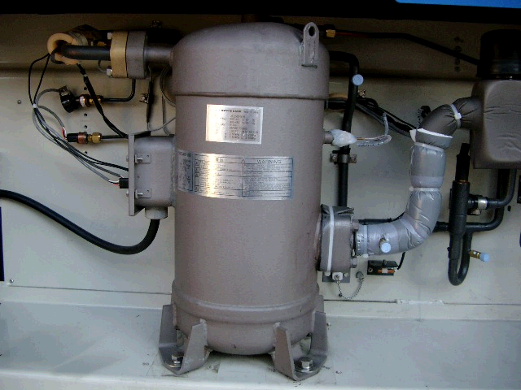
Replacement of compressor
1.Removal of compressor
【Scroll compressor】
Flare nut for
Injection piping
Discharge flange
①
Collect the refrigerant from the service port ④ & ⑤.
Open the terminal box cover to disconnect the wires.
Remove the bolts for suction flange and discharge flange.
Remove the flare nut for the intermittent injection and gauge piping.
Remove the compressor mounting bolts.
②
Flare nut for
Gauge piping
③
④
⑤
Suction flange
Terminal box
Terminal, name plate
Mounting bolts × 4

Slide 2
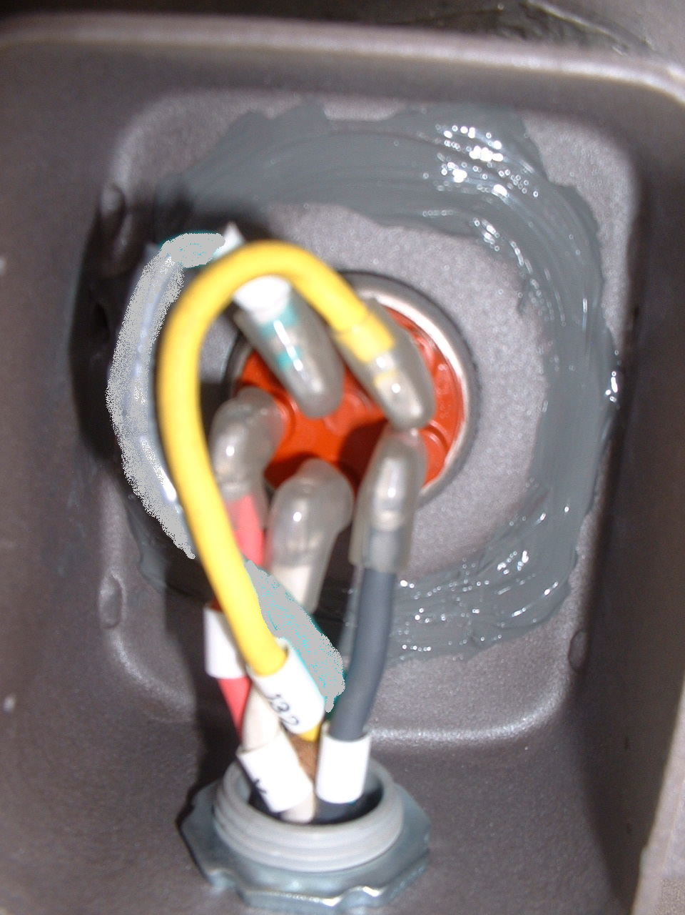
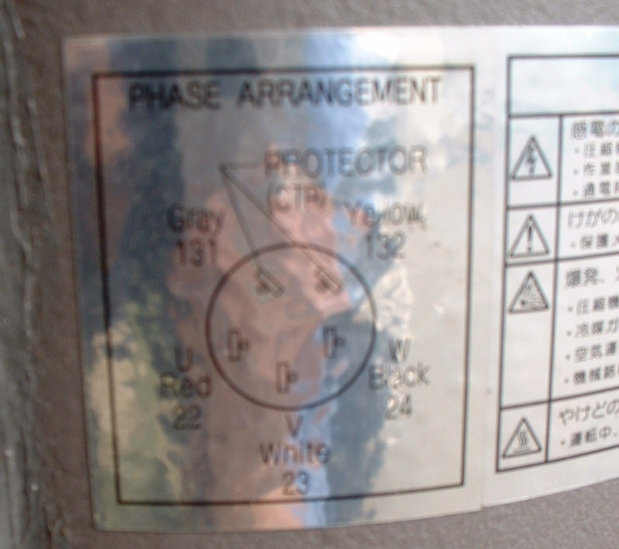
Replacement of compressor
【Terminal box】
Lay wires at the left side
of the terminal board.
CTP
Terminal, name plate
Pay an utmost attention not to wire incorrectly for the compressor.
Otherwise, the compressor may turn in reverse direction causing burn out.
Wire color
Wire number
Gray
131
yellow
132
Red
22
White
23
BLACK
24

Slide 3
Replacement of compressor
2.Installation of compressor
①
Fix the compressor base with mounting bolts
Apply new gaskets to the suction and discharge flange and fix them with bolts.
Tighten the flare nut for intermittent injection and gauge piping.
Connect wires to the terminals and put the cover on.
Apply a silicon sealant on the flare nut section of gauge piping.
Tightening torque
②
Parts | Tightening torque
Mounting bolt | 42.7N・m
Suction flange | 25.2N・m
Discharge flange | 25.2N・m
φ6.4 Flare nut | 15.7N・m
φ9.5 Flare nut | 36.3N・m
③
④
⑤

